Slide 1
Data Structures
Topics Covered :
Overview & Why
Classification of Data structures
Array & Operations
Linked List & Opertions
Doubly Linked List & Operations
Circular Linked List
Stack & Implementation
Queue & Implementation
By,
Jishnu T U
C-DAC Trainer

Slide 2
Overview & Why ?
Way of organizing data
Reduce the space and time complexities of different tasks.
High speed in processing
Efficiency of a program
Reusability and Abstraction

Slide 3
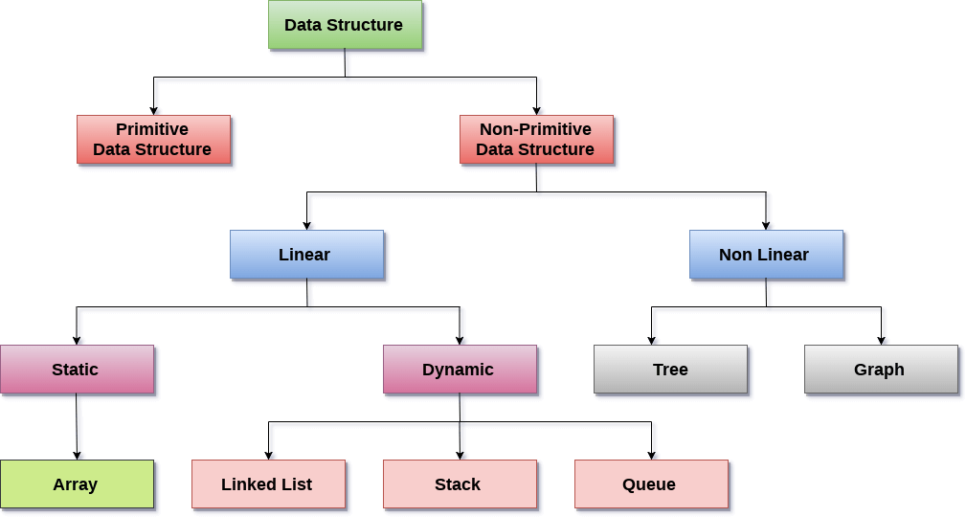
Data Structure Classification

Slide 4
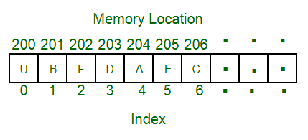
Array
Linear data structure
Elements are stored at contiguous memory locations.
Store multiple items of the same type together
Advantages :
Random access is allowed
Ease of insertion and in Accesss
Drawbacks:
Static memory allocation
Deletion requires Shifting of elements

Slide 5
Array - Accessing Element
Accessed using an index number
First element is numbered 0, so that the indices in an array of 10 elements run from 0 to 9.
Complexity : O(1)
temp = myArray[3];

Slide 6
Array - Insertion of Element
Unsorted
Keep track of number of elements in array - nElts
Insert using index and Increment the tracking object
Complexity : O(1)
Sorted
Requires Searching for the postion
Shifting the elements to make the specfied postion to be vacant.
Complexity : O(N²)
arr[0] = 77
arr[nElts] = 12
nElts = nElts +1

Slide 7
Deletion of Element
Begins with a search for the specified item
When we find it, we move all the items with higher index values down one element to fill in the “hole” left by the deleted element
decrement nElems
for(j=0; j<nElems; j++) // look for it
if(arr[j]== eltToBeDeleted){
for(int k=j; k<nElems; k++) // higher ones down
arr[k] = arr[k+1];
nElems--; // decrement size
break;
}
}

Slide 8
Linked list
Linear data structure
Elements are not stored at contiguous memory locations.
Elements are linked using pointers
Advantages :
Dynamic size (dynamic memory allocation)
Ease of insertion/deletion over unsorted approach
Drawbacks:
Random access is not allowed
Extra memory space for a pointer

Slide 9
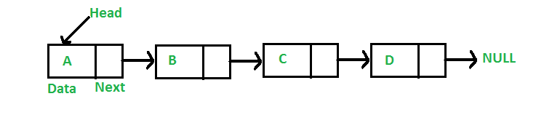
Singly Linked List
class Node
{
public int data;
public Node *next;
};
Node
Each element in the List
consists of at least two parts:
Data
Pointer (Or Reference) to the next node
Tracking Element : Head/First
Linked List

Slide 10
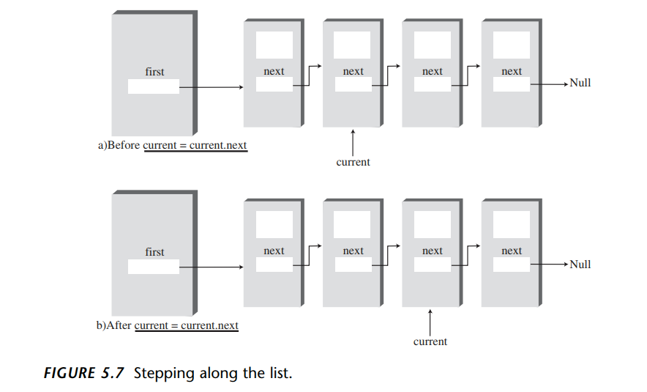
Linked List: Accessing Element

Slide 11
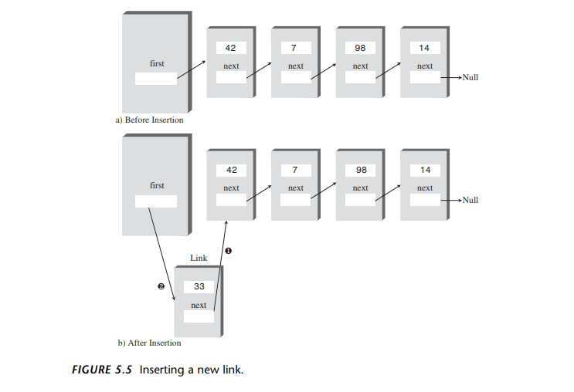
Linked List:Insertion of Element

Slide 12
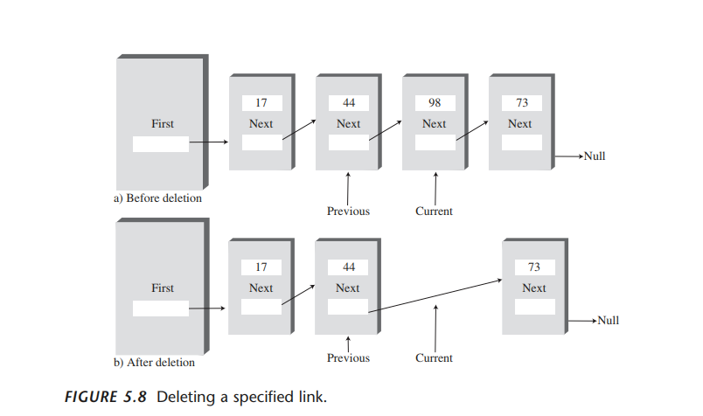
Linked List:Deletion of Element

Slide 13
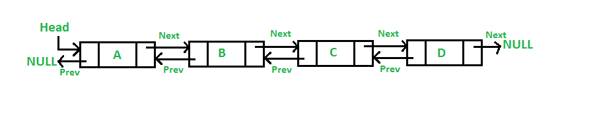
Doubly Linked List
class Node
{
public int data;
public Node *next;
public Node *prev;
};
Node
Each element in the List
consists of at least three parts:
Data
Pointer (Or Reference) to the next node
Pointer Or Reference) to the previous node
Tracking Element : Head/First and Last/Tail
Linked List

Slide 14
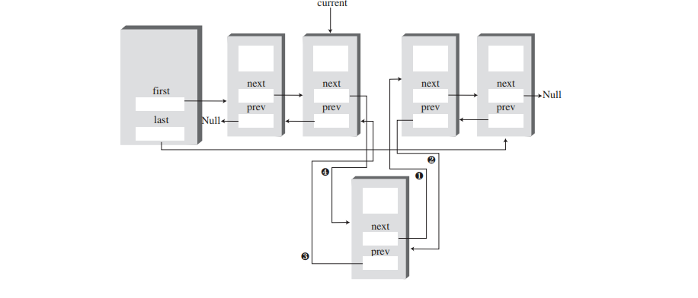
Doubly Linked List:Insertion of Element

Slide 15
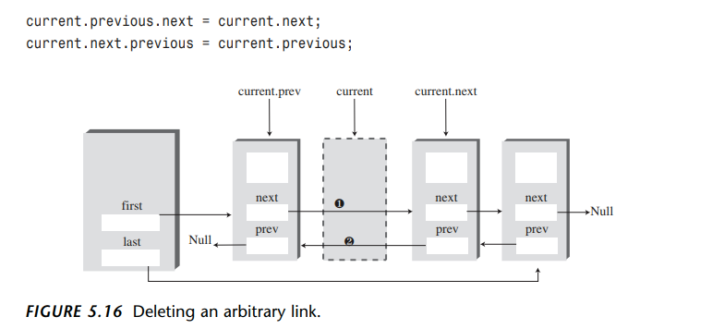
Doubly Linked List:Deletion of Element

Slide 16
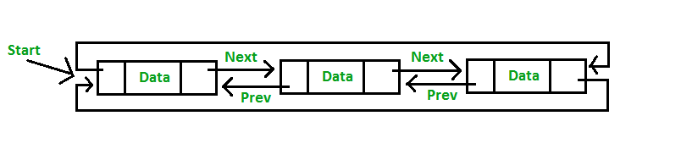
Circular Linked List
class Node
{
public int data;
public Node *next;
public Node *prev;
};
Node
consists of at least three parts:
Data
Pointer (Or Reference) to the next node
Pointer Or Reference) to the previous node
Two consecutive elements are linked or connected by previous and next pointer
Last node points to first node by next pointer
First node points to last node by previous pointer
Linked List

Slide 17
Stack
Linear data structure
New element is added at one end and (top) an element is removed from that end only.
LIFO(Last In First Out) or FILO(First In Last Out).
Example : plates stacked over one another
Can be Implemented using Array or Linked List
Tracking Element : Top
Application :
Processing of subroutine calls and returns
reversing a string
backtracking - Eg :- Maze Game

Slide 18
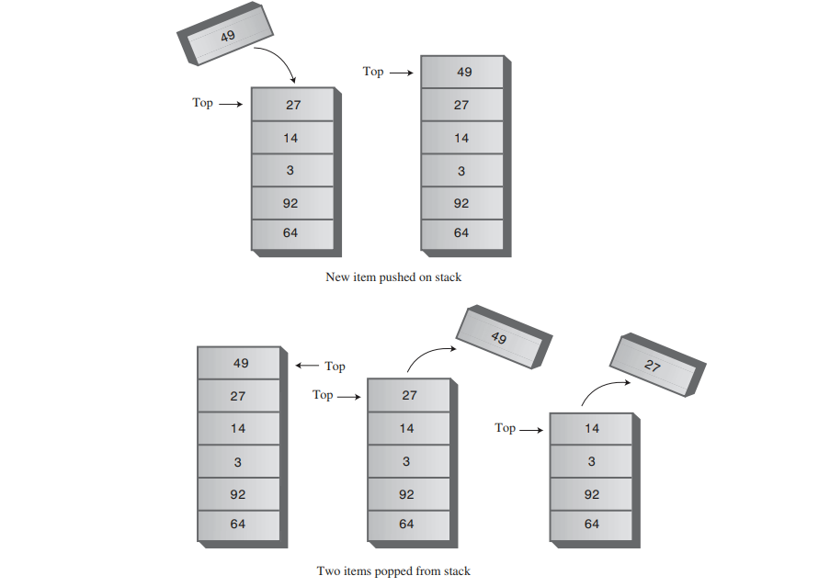
Stack Example

Slide 19
Implementation
class StackX
{
private int maxSize; // size of stack array
private long[] stackArray;
private int top; // top of stack
-------------------------------------------------------
public void StackX(int s) // constructor
{
maxSize = s; // set array size
stackArray = new long[maxSize]; // create array
top = -1; // no items yet
}
-------------------------------------------------------
public void push(long j) // put item on top of stack
{
stackArray[++top] = j; // increment top, insert item
}

Slide 20
Cont.
public long pop() // take item from top of stack
{
return stackArray[top--]; // access item, decrement top
}
-----------------------------------------------------
public long peek() // peek at top of stack
{
return stackArray[top];
}
-------------------------------------------------------
public boolean isEmpty() // true if stack is empty
{
return (top == -1);
}
-------------------------------------------------------
public boolean isFull() // true if stack is full
{
return (top == maxSize-1);
}
-------------------------------------------------------
} // end class StackX

Slide 21
Queue
Linear data structure
New element is added at one end and (rear) an element is removed other end (front).
First In First Out (FIFO)..
Example : Queue for Customer Service
Can be Implemented using Array or Linked List
Tracking Element : Rear and Front
Applications :
Time sharing system
Load Balancing system- Eg:- AWS-SQS, Hold for Tech Support
Print spooling,

Slide 22
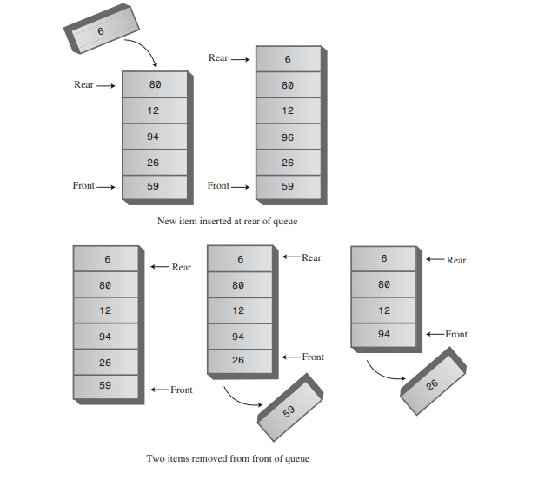
Queue Example

Slide 23
Implementation
class Queue
{
private int maxSize;
private long[] queArray;
private int front;
private int rear;
-----------------------------------------------------
public Queue(int s) // constructor
{
maxSize = s+1; // array is 1 cell larger
queArray = new long[maxSize]; // than requested
front = 0;
rear = -1;
}
-------------------------------------------------------
public void insert(long j) // put item at rear of queue
{
if(rear == maxSize-1)
rear = -1;
queArray[++rear] = j;
}

Slide 24
public long remove() // take item from front of queue
{
long temp = queArray[front++];
if(front == maxSize)
front = 0;
return temp;
}
------------------------------------------------------
public long peek() // peek at front of queue
{
return queArray[front];
}
------------------------------------------------------
public boolean isEmpty() // true if queue is empty
{
return(rear+1==front || (front+maxSize-1==rear) );
}
------------------------------------------------------
public boolean isFull() // true if queue is full
{
return (rear+2==front ||(front+maxSize-2==rear) );
}
} // end class Queue

